Slide 1
Management by Objectives

Slide 2
Introduction
Catherine Turner has newly joined Alistair Software Inc. as a Software Tester.
She has about three years of experience working as a Software Tester in her previous organization, Maxus Software Services Inc.

Slide 3
Introduction
After joining Alistair, Catherine learned that the management of this organization is very different from her previous organization.

Slide 4
Introduction
Neil explained to Catherine that Alistair followed the ‘Management by Objectives’ process to help set goals for each of its employees so that the employees know what they are supposed to do at the workplace.

Slide 5
Introduction
As a result, the employees at Maxus did not know what was expected out of them.
The employees did not understand how they could better contribute more effectively towards the success of the organization.

Slide 6
Introduction
Catherine found that the ‘Management by Objectives’ process followed at Alistair Inc. helped to clearly define her roles and responsibilities for herself.
It also helped to chalk out her future course of action in the organization.

Slide 7
Introduction
‘Management by Objectives’ is the process of setting objectives in the organization to give a sense of direction to the employees.
It refers to the process of setting goals for the employees so that they know what they are supposed to do at the workplace.
Let us learn about ‘Management by Objectives’ in detail.

Slide 8
Objectives
Explain What is meant by Management by Objectives
Describe Who advocated the concept of MBO
Explain the Need for MBO
Explain the Four Basic Principles of MBO
Explain Objective Setting & SMART Objectives in MBO
Explain the Classification of Objectives
List the Pre-requisites for a Good Objective
Describe the Three Constituent Processes of MBO
Explain Who can Use MBO
Explain the Strategies for Making MBO Effective
List the Benefits of MBO to Organization and Employees
List KRAs Managers should Focus for Clear Objectives
Explain the Features of MBO
Explain the Steps of the Process of MBO
Explain the Pitfalls of MBO

Slide 9
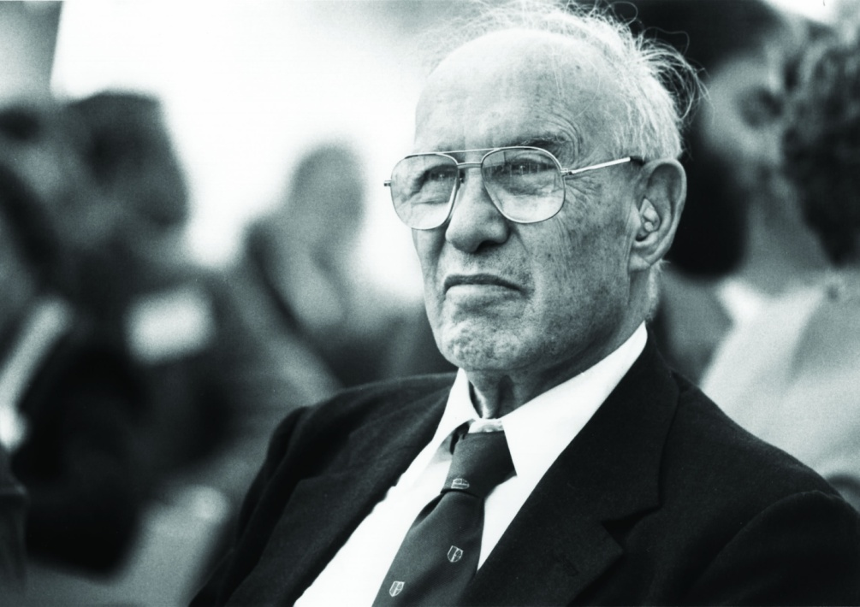
What is meant by Management by Objectives?
The term ‘Management by Objectives’ was coined by Peter Drucker, in the year 1954. It is also commonly referred to as ‘MBO’.

Slide 10
Need for Management by Objectives (MBO)
The following are some of the points that prove the need for ‘Management by Objectives’ (MBO) in organizations:
The ‘Management by Objectives’ process helps the employees to understand their duties at the workplace.
‘Key Result Areas’ or ‘KRAs’ are designed for each employee as per their interest, specialization and educational qualification.
The employees are clear as to what is expected out of them.
The process of ‘Management by Objectives’ leads to satisfied employees.

Slide 11
Classification of Objectives
Objectives can be broadly classified under the following heads:
Work Objectives
Targets
Tasks/Projects
Behavioral Parameters
Values
Performance Improvement
Developmental Objectives
Let’s look at each in detail.

Slide 12
Tip!
Managers often fall into what is known as the ‘activity trap’ and hence tend to lose sight of their objectives.
Managers should avoid losing focus of their objectives by avoiding falling into this ‘activity trap’ where they get so trapped and involved in their current activities that they forget their original purpose.

Slide 13
Steps of the Process of MBO
The MBO Process includes the following steps:
Step 1: Determining Objectives
Step 2: Identification of Key Result Areas (KRAs)
Step 3: Determining Subordinates Objectives
Step 4: Revision of Organizational Structure
Step 5: Matching Objectives and Resources
Step 6: Conducting Periodic Progress Reviews
Step 7: Performance Appraisal
Step 8: Providing Feedback
Let us look at each in detail.

Slide 14
ManagementStudyGuide.com
This is a DEMO Course On – Management By Objectives
Subscribe Today and Get Access to 250+ Course Presentations.
What You Get:
Access the Courses Online.
Download Powerpoint Presentation for Each Course.
Get Certificates.

