Slide 1
Advanced Emotional Intelligence
1
2
3
and Personal Skills

Slide 2
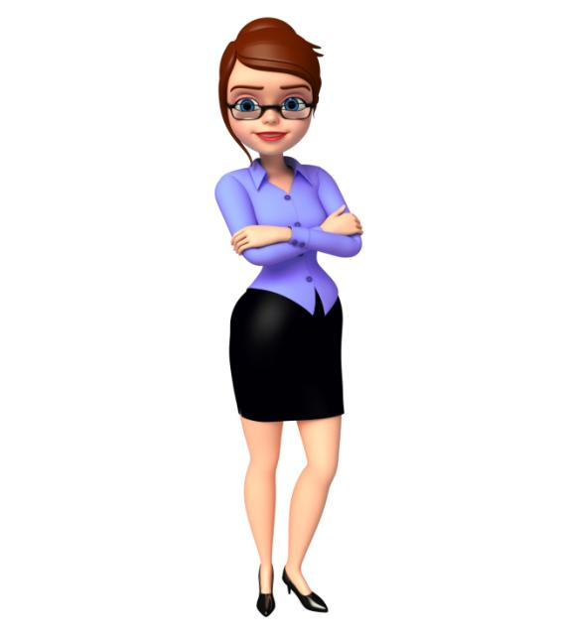
Prerequisite
Before going through this course, it is highly recommended that you first go through the course titled 'Emotional Intelligence' to get a basic understanding of the following concepts:
What is Emotional Intelligence (EQ)?
Brief History of Emotional Intelligence
Benefits of Emotional Intelligence
Relation between Brain and Emotions
Various Competencies of Emotional Intelligence
Principles of Building Your Emotional Intelligence
Difference between People with High EQ and Low EQ

Slide 3
Course Objective
Describe the Role of Self-awareness in EI
Explain How to Balance Personal and Work Life
Explain How to become More Self-aware
Explain How to Increase Your Self-regard Level
Explain How to Handle Your Fears
Explain How to Boost Your Self-esteem
Explain What is a Power Continuum
Explain What is Self-talk
Explain the Steps to Self- Motivate Yourself
Explain the Stages of the Behavior Cycle
Explain Steps to get to Root Cause of Emotions
Explain What is meant by ‘Emotional Flooding’
Explain the Steps for Preventing Flooding
Explain the Types of Strokes
List the Characteristics of Good Personal Skills

Slide 4
Introduction
Gavin Kellar works as a Senior Sales Executive at Rabiton Inc. Gavin had joined Rabiton as a Trainee Sales Executive just two years ago. In two years, he surpassed everyone’s expectations and performed wonderfully. He also got promoted very quickly to the position of a Senior Sales Executive.

Slide 5
Introduction
Normally, a trainee sales executive may take about four years to become a Senior Sales Executive.
In fact, people at Rabiton believed that there is no client that Gavin can’t handle and get a sale from.

Slide 6
Introduction
So, how did Gavin achieve this marvellous deed?
Let us see what makes Gavin a star performer and a stellar salesperson?

Slide 7
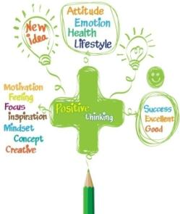
Introduction
After raising his self awareness, Gavin decided to become more optimistic and have a positive attitude towards everything. He also decided to make an effort in becoming more self-confident. These changes created wonders for Gavin’s sales career which pushed him form a poor performer to a start performer.

Slide 8
How to Develop Your Emotional Intelligence?
Your subconscious mind is in constant dialog with yourself.
Your inner voice can act as a powerful coach to help you enhance and raise your emotional intelligence levels.
So, whenever you are awake, this inner voice speaks to you and lets you know information.

Slide 9
How to Analyze and Balance Personal and Work Life?
A person can be considered successful in life only when he is successful on both personal as well as professional front.
Success on both the personal and professional fronts can be achieved only when a person knows to maintain a good balance between personal and professional life.
In order to balance between both personal and professional fronts, you should first analyze your life.

Slide 10
What is a Power Continuum?
Your Power
Other Person’s Power
Only Single Person Participation
Tokenism
Representation
Partnership
Consultation
Mentoring

Slide 11
Positive Self-talk Phrases
You CAN DO everything, but not all at once.
You CAN DO everything, if it’s important enough for you to do.
You CAN DO everything, but you may not be the best at everything.
You CAN DO everything, but there will be limitations.
You CAN DO everything, but you’ll need help.

Slide 12
Termination/Advocacy/Transcendence/Relapse
Stage 6:
Termination /Advocacy/Transcendence/Relapse -
At this last stage of the behaviour cycle, the person has completely broken free of the undesirable habit.
He has stopped the undesirable behavior and now does not even face the problem of saying ‘no’ to it easily.
Stage #1
Stage #2
Stage #3
Stage #4
Stage #5
Stage #6

Slide 13
Real Life Example
Dan started to drink daily to ease his stress and feel relieved. However, soon things got out of control and Dan lost interest in his work. He started ignoring his professional and personal life. He started to drink throughout the day and remained absent from work for many days continuously.

Slide 14
ManagementStudyGuide.com
This is a DEMO Course On – Advanced Emotional Intelligence & Personal Skills.
The Complete Course Presentation consists of 271 Slides.
Become a Member and Get Access to Complete Powerpoint Presentations for more than 250+ Subjects.
What You Get:
View All Courses Online.
Download Powerpoint Presentation for Each Course.
Do the Knowledge Checks for Each Course.

