Slide 1
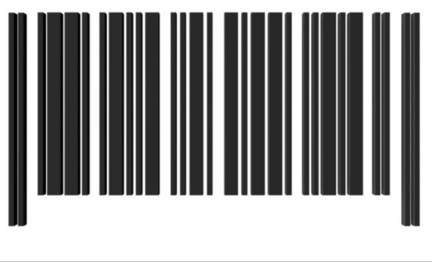
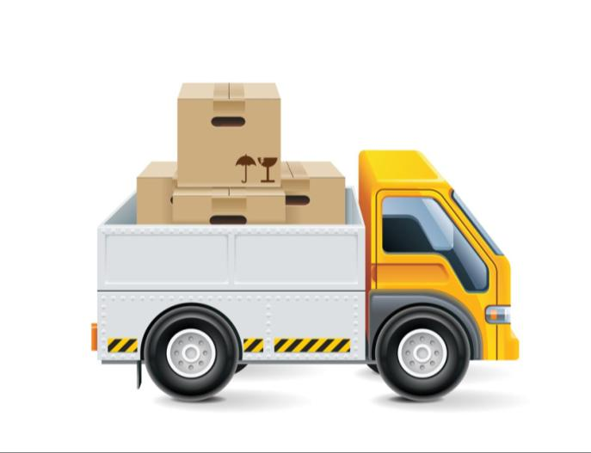
Retail SCM Distribution and Logistics

Slide 2
Course Objective
Explain What is Retail Supply Chain Management
Describe the Basic Supply Chain in Retailing
Explain What is Supply Chain Node Design (SCND)
Explain the Role of Logistics in Retail SCM
Describe the Strategies for Retail Logistics Management
Explain the Steps of Cross Docking Process
Explain the Push/Pull Strategies of SCM
Explain the Retail Warehouse Management System
Describe the Key Strategies for Distribution Management
Explain the Factors Contributing to Bull Whip Effect
Explain the Types of Retail Supply Chain Models
Describe the Role of Information Technology in Retail SCM
Explain the Role of Reverse Logistics in Retail SCM
List the Challenges of Retail SCM
List the Tips for Effective Retail SCM

Slide 3
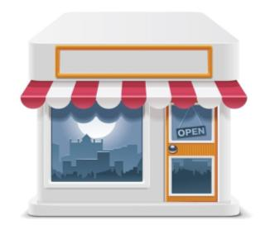
Introduction
You & Us
Kate Slovensky is a housewife and regularly visits her local supermarket, ‘You & Us’ to shop for groceries, clothes and fruits.

Slide 4
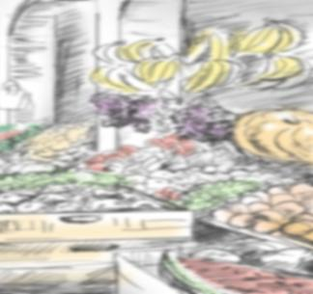
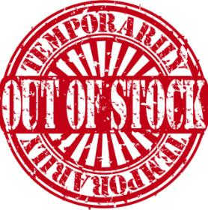
Introduction
However, lately she has found that many of the brands that were earlier available with ‘You & Us’ are most of the times ‘out of stock’. She is greatly disappointed by the lack of options in some of her key needed brand of products such as Cosmetics, Shampoo, and Coffee etc.

Slide 5
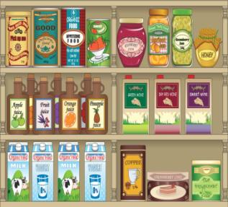
Introduction
Kate has been thinking of going to another retail store where she would be able to get more options of choosing various products such as of national or local brands, private label products of economy, value or premium quality or fresh or canned products.

Slide 6
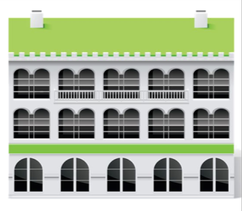
Introduction
Therefore, Kate decides to try one of the bigger stores for the brands that she is looking for. There are many large retailers available in her city such as the ones shown on the screen.

Slide 7
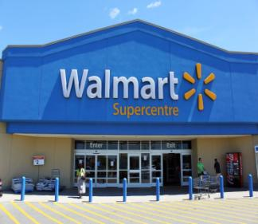
Introduction
Each of these retailers stocks various brands of products in different categories. Kate decides to try ‘Wal-Mart’ for her shopping needs. ‘Wal-Mart’ is a successful retailer that is engaged in selling merchandise for personal or household consumption.

Slide 8
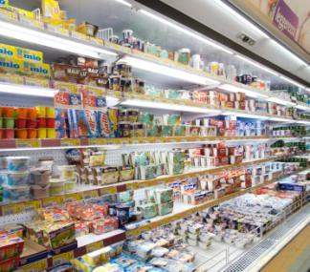
Introduction
Kate finds as she goes to ‘Wal-Mart’ to shop month after month for her groceries and other needs that ‘Wal-Mart’ always has a good stock of all the various brands every time. She never finds any brand being ‘out of stock’. Thus, Kate is able to buy the brands that she likes every time.

Slide 9
Introduction
So, how does ‘Wal-Mart’ achieve this good stock of various brands?
How is ‘Wal-Mart’ able to satisfy the needs of Kate as well as several of its customers and please them every time?

Slide 10
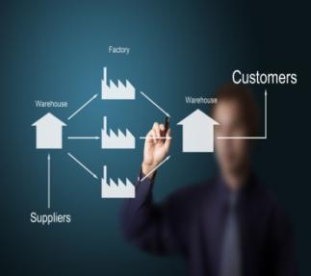
Introduction
‘Retail Supply Chain’ is the flow and management of resources across the retail enterprise for the purpose of maintaining the business operation profitably. It is the management of a network of all retail business processes and retail activities involving procurement of raw materials, manufacturing and distribution management of Finished Goods.

Slide 11
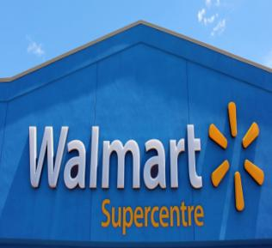
Introduction
‘Wal-Mart’ achieves this stupendous success with each of its customers through the use of a very effective and efficient ‘Retail Supply Chain Management’ and ‘Logistics System’.

Slide 12
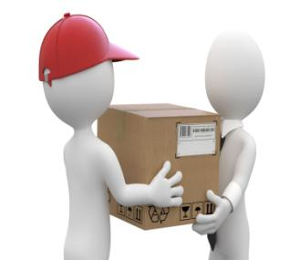
Introduction
‘Retail SCM’ is also called the ‘Art of management of providing the Right Product, At the Right Time, Right Place and at the Right Cost to the Customer’. An effective and efficient ‘Retail Supply Chain Management’ and ‘Logistics System’ is crucial for each and every retail business’ success.

Slide 13
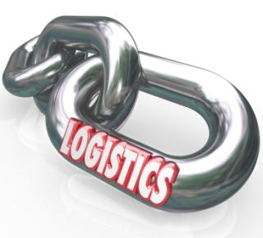
Introduction
Let us look at the various aspects of ‘Retail SCM Distribution and Logistics’ in detail.
Thus, a strong and efficient ‘Retail Supply Chain Management’ and ‘Logistics System’ provides a firm foundation and backbone for success in any kind of retail business whether the retailer comprises of street vendors, local grocery stores, supermarkets, automobile showrooms, internet kiosks, home appliance showrooms, direct marketers, etc.

Slide 14
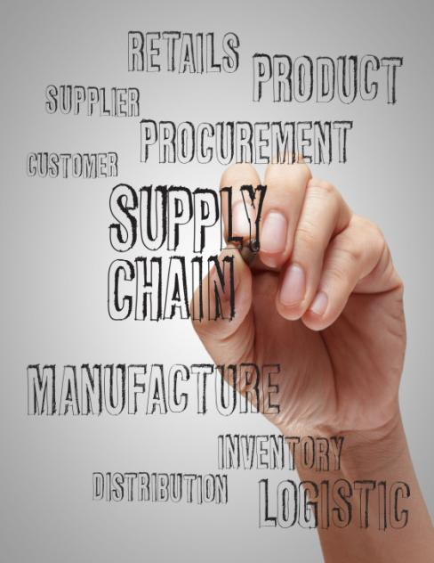
What is Retail Supply Chain Management?
Supply Chain is the flow and management of resources across the retail enterprise for the purpose of maintaining the retail operation profitably.
‘Retail SCM’ can be defined as the management of a network of all retail business processes and activities involving procurement of raw materials, manufacturing and distribution management of finished goods to reach the end user. SCM is also called the art of management of providing the Right Product, At the Right Time, Right Place and at the Right Cost to the Customer.

Slide 15
Drivers of Retail Supply Chain Dynamics
A retail supply chain is dynamic and chaotic, so, its structure must be very flexible to cope with capricious market demand and severe levels of competitions. A supply chain must be able to change its pattern easily to gain a competitive advantage.
Drivers
Customer satisfaction
Technology change
Connections
Internal factors
Multi-echelon decision making
Scratched together partners
Retail Supply Chain Dynamics
Roll your mouse over the icon, to learn more.
Competitiveness
Flexible manufacturing
Efficient operation
Agility response
Negative effects
Information-distortion/delay
Bullwhip effect
Boom and bust

Slide 16
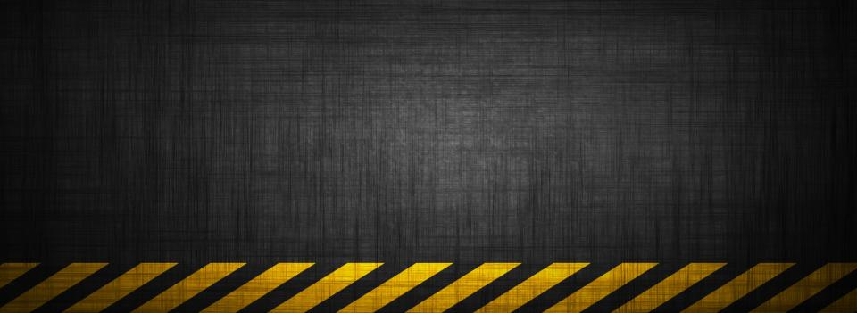
Solutions provided by Retail SCM
1
Distribution Network Configuration :
Location, network of suppliers, distribution centers, production centers, warehouses, customers etc.
2
Distribution Strategy:
Control of operations, delivery scheme, mode of transportation, replenishment strategy and transportation control
3
Trade-offs in Logistics:
All the activities must be well coordinated to achieve the lowest total logistics cost. Trade-offs may increase the total cost if only one of the activities is optimized

Slide 17
Retail Supply Chain Planning and Execution Function
PLANNING
BUY
DISTRIBUTE
SELL
Sourcing
Replenishment planning
Vendor Management
Network Planning
Demand Management
Inventory Planning
Demand Planning
EXECUTION
Transportation
Demand Management
Warehousing
Order Management
Inventory Management

Slide 18
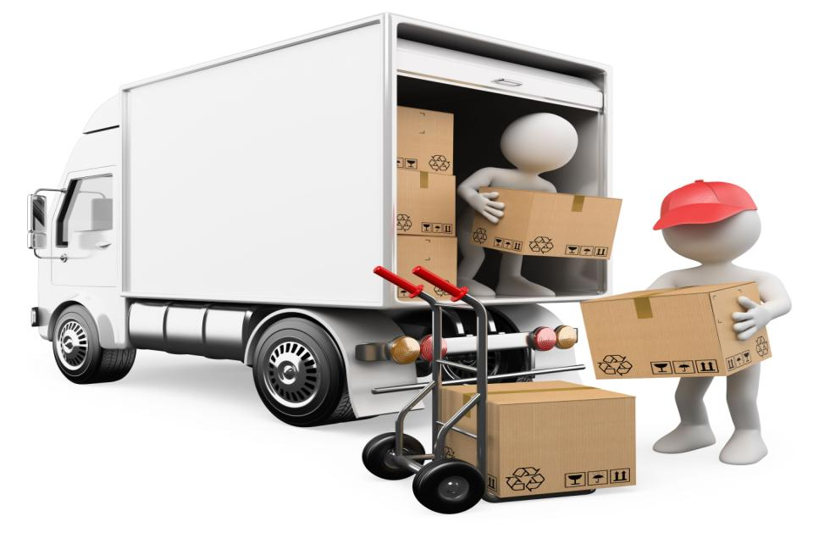
Retail SCM & Allocation Planning
Allocation planning is another strategy for replenishments. This type of replenishment strategy is sometimes called as pull-based strategy. This is because the replenishment at any given node is based on the demand signals from the downstream node that pulls the merchandise from the target node. Consider a retail store that requests merchandise from the warehouse when needed. This is an example of pull-based replenishment, where the retail store pulls the merchandise from the warehouse as need arises.

Slide 19
Retail Supply Chain & SCND
These desirable locations will constitute the retail supply chain for most efficient flow of materials and merchandise.
Supply Chain Network Design or ‘SCND’ is the process of establishing the network nodes and flow paths in a retail supply chain.
Supply chain network design is a critical process for distribution-intensive industries such as retail.
Together, this network creates a complex set of flow paths along which the merchandise can flow.
This process helps plan the most desirable physical locations and their types.
These nodes can represent either manufacturing, stocking or distribution locations.

Slide 20
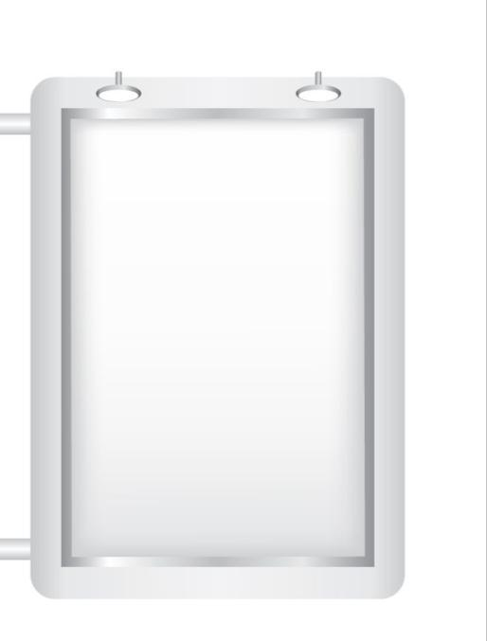
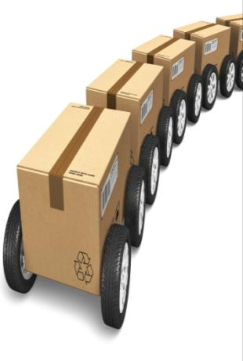
Logistics in Retail Supply Chain Management
‘Logistics’ is the backbone on which Retail Supply Chains are driven.
Logistics refers to management of flow of goods and supplies involving information, data and documentation between two entities or points.

Slide 21
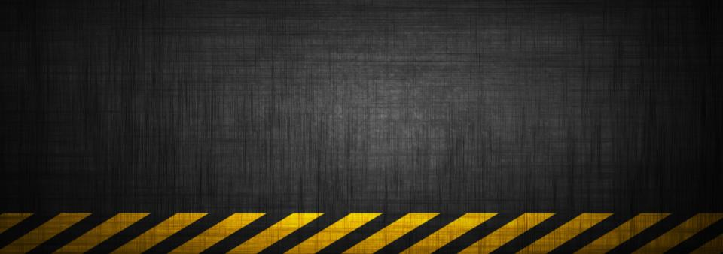
Key Strategies for Retail Logistics Management
3
1
There are three key strategies that are used by retailers for logistics management. They are as follows:
2
Flow-Time Analysis
Cross-docking
Hub and Spoke
Let’s look at each in detail.

Slide 22
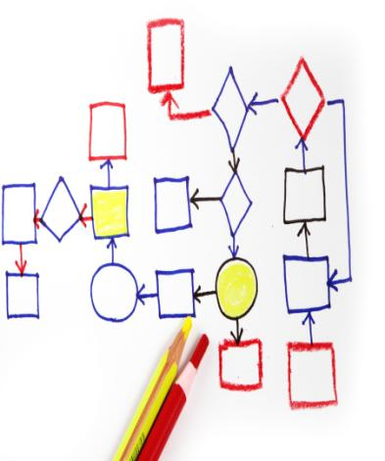
Flow-Time Analysis
3
It is obvious that shorter ‘flow times’ can prove to be a great competitive advantage for any retailer in today’s highly competitive retail market.
One of the most crucial components of retail supply chain is the speed with which the products move along the supply chain and ultimately reach the customer.
Hence, ‘flow time’ is the time it takes for the product to flow or move along the supply chain and reach the customer after the customer demand is made.
Flow-Time Analysis

Slide 23
Push/Pull Strategies of SCM
Pull
Customization is High
Demand is uncertain
Scale economies are Low
E.g., Computer Peripherals
Demand is uncertain
Scale economies are High
Low economies of scale
E.g., Furniture
High
Demand of uncertainty
Uncertainty is low
Low economies of scale
Push-pull supply chain
E.g., Stationeries
Standard processes are the norm
Demand is stable
Scale economies are High
E.g., Soft drinks
Low
Low
High
Push
Economies of scale
Pull
Push

Slide 24
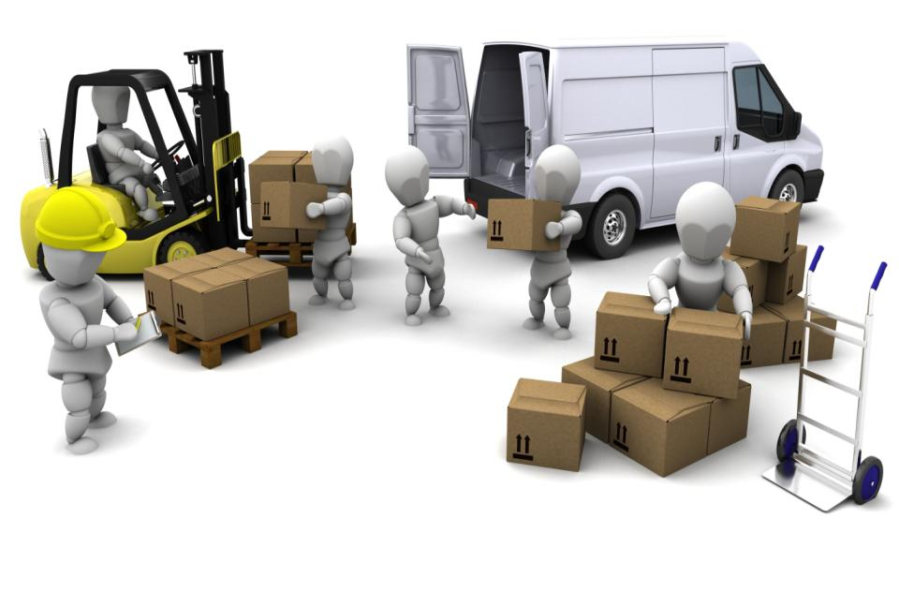
Retail Distribution & Warehouse Management System
Many factors and elements contribute to successful operations of a retail distribution center. The time taken to detail the project and build a model taking into account all considerations will go a long way in ensuring operational efficiency of the retail supply chain.

Slide 25
Cycle Count Process
The Warehouse Management System carries out the following functions:
Another critical function of WMS is the cycle count process which is required to maintain the health of the inventory. WMS initiates daily cycle count and wall to wall counts as per user specification and attributes.
Reporting Function
Cycle Count Process
Operations Front Functions
Inventory Front Functions
Let us look at each in detail.

Slide 26
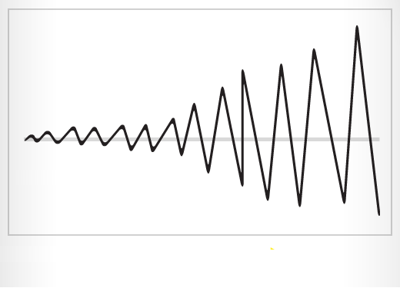
Bull Whip Effect
The given image shows how the ‘Bull Whip Effect’ has distorted the actual number of products required at the point of sale as compared to the number of products being manufactured at the manufacturer’s factory.
Quantity of Products
Customer
Supplier
Manufacturer

Slide 27
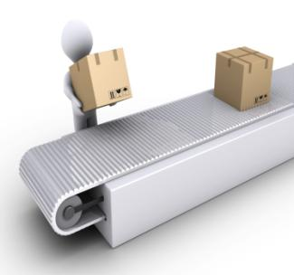
Vendor Managed Inventory (VMI)
VMI concept aims to reduce inventory in the pipeline, besides achieving the concept of ‘JIT - Just In Time’ where in the ownership of the inventory lies with the supplier until the time of usage or sale where it gets transferred to the retailer.

Slide 28
Model 1: Online-Only/In-House Supply Chain
Model 1:
Online-Only/In-House Supply Chain
The ‘Online-Only/In-House Supply Chain’ Model focuses on fulfilling orders quickly with a high rate of accuracy and also optimizing shipping times to customers. This model achieves this quick turnaround time by greatly depending upon extensive product sales forecasting and inventory management systems.
An example of a retailer who uses this model is: Amazon.com

Slide 29
Reverse Logistics in Retail SCM
As Retail Supply Chain Activities are evolving and partnering changes in business models, the focus and activities are not restricted to management of raw materials and finished goods from point of origin from the vendors to retailers and further on to the end customers.
There is another extension to Retail Supply Chain Process known as ‘Reverse Logistics’.
Reverse Logistics deals with the planning, process and flow of finished goods inventory, packaging materials and parts of finished product back from end customer to the retailer as sales return or warranty return or unsold inventory with trading partners.

Slide 30
ManagementStudyGuide.com
This is a DEMO Course On – Retail SCM Distribution & Logistics. The Complete PPT consists of 248 Slides.
Become a Member and Get Access to Complete Powerpoint Presentations for more than 140 Subjects.
What Do you Get:
View All Courses Online.
Download Powerpoint Presentation for Each Course.
Do the Knowledge Checks for Each Course.

