Slide 1


Introduction to
Medical Tourism

Slide 2






Introduction
Look at the three people on the screen.
Click each person to meet them and listen to their story.

Slide 3

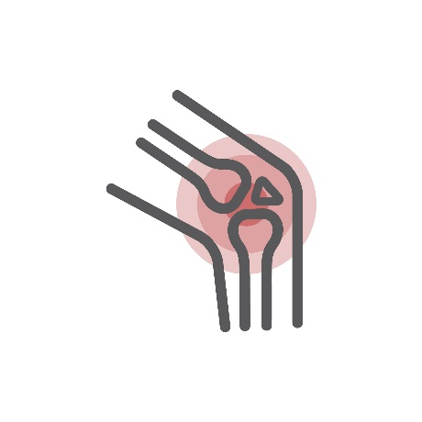



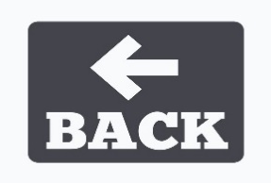
Introduction
  Hello there! I’m Samantha, a retired widow living in New York.
  I have been suffering from knee pain for many years. My doctor says that I need to get a knee replacement surgery done.
  I know that such surgeries cost a ton and it takes a lot of time to recover post the operation.
  I really wonder, how would I afford the surgery and the post-op care on my menial pension and insurance?

Slide 4

Introduction
They decide to visit a website to find out how and where to avail cheap medical and health services.
After inputting their details on a built-in Artificial Intelligence-based survey, the website suggested some options to them.

Slide 5


Introduction
Samantha is heading to Mexico.

Slide 6


Introduction
  Mexico has a strong medical workforce of well-trained doctors and nurses.
  It also boasts of some of the state-of-the-art infrastructure when it comes to healthcare facilities.
  In fact, Samantha could take her best friend Ruth with her and she was given all the facilities of stay and food included in Samantha’s healthcare package.
  Samantha ended up paying half the price of that, which was quoted in the US for her surgery and post-op care.

Slide 7
Introduction
‘Medical Tourism’ is a combination of two leading service industries – the Healthcare and the Tourism industry.
‘Medical Tourism’ provides people with accessibility, state-of-the-art healthcare infrastructure, and quality, all at affordable prices.

Slide 8

Objectives
Explain What is meant by ‘Medical Tourism’
Describe the Advent of Medical Tourism Industry
Explain the Importance of Medical Tourism
List the Stakeholders in the Medical Tourism Industry
Explain Why Patients Opt for Medical Tourism
Explain the Determinants of Medical Tourism
Describe the Factors that Affect Choice of Medical Tourists
List the Top Countries Offering Medical Tourism
List the Main Procedures Offered in Medical Tourism
Explain Benefits of Medical Tourism – For the Patients
Explain Benefits of Medical Tourism – For the Host Country
Describe the Myths Around Medical Tourism
Explain the Challenges Faced by Medical Tourists
Explain the Challenges Faced by Healthcare Providers
Describe the Future of Medical Tourism Industry

Slide 9
The Advent of the Medical Tourism Industry
The concept of medical tourism started way back thousands of years ago.
It is a social practice that started in the healthcare field in the ancient times.
Researchers have found that several sites found in India, Persia, Egypt, and Greece had several travellers across them solely for the purposes of getting medical treatment.

Slide 10

Importance of Medical Tourism
‘Medical Tourism’ has gained a lot of significance over the years due to the following reasons:
‘Medical Tourism’ offers highly-competitive healthcare packages at prices, which are much lower than those in the western countries.
It helps patients avail healthcare services using state-of-the-art infrastructure and technology, which may not be available or may be too expensive in their country.

Slide 11

Stakeholders in the Medical Tourism Industry
These stakeholders are:
Medical Tourists
Healthcare Providers
Policies and Government
Insurance Companies
Trade Shows & Events
Agencies
Marketing Elements
Let us look at each in detail.

Slide 12
Benefits of Medical Tourism – For Host Country
Most of the medical tourists come from developed nations to these developing countries. So, they enjoy a better financial position as they come from high-income countries.
Hence, they bring in a lot of money into the destination country, when they come for treatment.

Slide 13

Future of Medical Tourism Industry
According to a survey, it has been found that the number of patients travelling abroad for availing healthcare services increases every year by almost 20%.
This has given rise to a boost in the economy of the host countries by several billions of dollars.

Slide 14


ManagementStudyGuide.com
This is a DEMO Course On:
Medical Tourism
Subscribe Today and Get Access to 250+ Course Presentations.
What You Get:
Access the Courses Online.
Download Powerpoint Presentation for Each Course.
Get Certificates.

