Slide 1
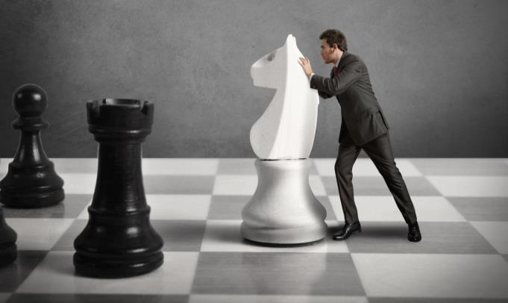
Strategic Game Theory for Managers

Slide 2
Course Objectives
Explain What is the Game Theory
Explain the Basic Elements of a Game
Explain the Importance of Game Theory
Explain Co-operative & Non-cooperative Game Theory
Explain What is Zero-sum & Non-zero Sum Game
Explain What is a Payoff Matrix
Explain What is a Normal Form Game
Explain What is ‘The Prisoner's Dilemma’
Explain What is Nash Equilibrium
Describe Pure & Mixed Strategy Nash Equilibrium
Explain How to Use The Game Tree
Describe How to Anticipate Others’ Behavior in Game
Explain Steps to Apply Game Theory
List Applications of Game Theory in Strategic Mgmnt
Explain How Managers can Use Game Theory

Slide 3
Introduction
Let us now understand what Game Theory is all about.
There are various kinds of games that people play in real life.
You must have played any one or few of the following games:
The game of drivers manoeuvring in heavy traffic
Auctioning game played by bargain-hunters bidding on ecommerce or online shopping sites
Bargaining game played by a company and its union of workers trying to negotiate next year’s wage rise and bonus payout

Slide 4
Introduction
Political games played by two opposing candidates contesting in an election
Economic game played by a shop owner who decides on the kind of discounts and offers to offer to his customers
The game of love played by a man and a woman who try to capture each other’s attention and love
Adolf Hitler and Joseph Stalin played dictatorship and hate game that killed off a significant fraction of the world’s population

Slide 5
Introduction
Hence, you can understand that games are played in any situation when human beings interact with each other.
Likewise, even companies can be considered to be living entities that play games with each other.

Slide 6
Introduction
So, you can understand that there are a wide range of fields in which games are played.
This way game theory could be applied to predict how people will play the many games of which social life largely consists.

Slide 7
Introduction
So, you would think that game theory would become the all-purpose cure of all of the world’s problems arising due to human interactions.
However, you should understand that game theory is not able to solve all of the world’s problems.

Slide 8
Introduction
This is due to the fact that game theory works only when people play games rationally and using reason.

Slide 9
ManagementStudyGuide.com
This is a DEMO Course Presentation On – Strategic Game Theory for Managers.
Register Today and Get Access Complete Course Presentations on more than 150 Topics.
What Do you Get:
View All Courses Online.
Download Powerpoint Presentation for Each Course.
100% Editable Presentations.

Slide 10
Introduction
So, you should understand that game theory cannot predict the irrational behaviours in the love games of teenagers or the hate games of dictators such as Hitler and Stalin.

Slide 11
Introduction
The interesting thing is that most people do not behave irrationally. This is especially so in case of businesses and organizations. All business actions and decisions are made after rational and logical thinking.

Slide 12
Introduction
Therefore, game theory proves to be of great use in rational interactions between human beings as well as in businesses and their strategic management.

Slide 13
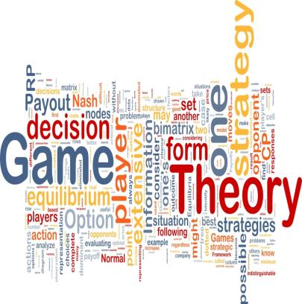
Introduction
Therefore, you can understand that an understanding of Game Theory is crucial for businesses as well as its managers to predict the actions and moves of the people around them including their competitors.
Let us learn about Strategic Game Theory for Managers in detail.

Slide 14
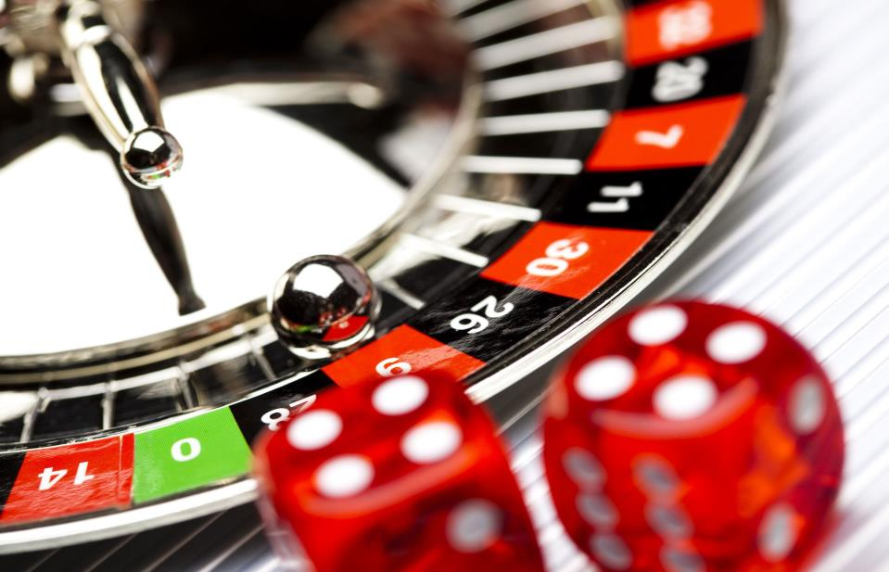
What is the Game Theory?
The main aim of a ‘Game Theory’ is to study the consequences of or find out what happens when self-interested parties or agents interact with each other.
You should understand that the word ‘self-interested’ in the context of Game Theory means that the involved each party or agent has his own description of which states of the world he likes.
This may even include good things happening to other agents.

Slide 15
Why Game Theory?
Game Theory is a crucial strategy that Managers as well as businesses should adopt for their success. The following are some of the reasons why Managers as well as businesses should understand and adopt Game Theory:
To understand, treat and win in the Business as war game
To get a better and broader view of one’s business situation
To understand and be successful in spectrum auctions to get a bandwidth of the airwaves which serve as the medium for radio and television broadcasting

Slide 16
ManagementStudyGuide.com
This is a DEMO Course Presentation On – Strategic Game Theory for Managers.
Register Today and Get Access Complete Course Presentations on more than 150 Topics.
What Do you Get:
View All Courses Online.
Download Powerpoint Presentation for Each Course.
100% Editable Presentations.

Slide 17
Utility Theory
The ‘Utility Theory’ is the most popular and dominant approach to help model a party’s or an agent’s interests.
The ‘Utility Theory’ is a theoretical approach which helps to quantify a party’s or an agent’s degree of choice or preference across a set of available options or alternatives.

Slide 18
What is ‘The Prisoner's Dilemma’?
‘The Prisoner's Dilemma’ is a game which involves a story. There are various different ways in which this story can be narrated. However, the essence of the game is that it involves two suspected criminals and police investigators. Also, the game involves the willingness of the suspects to confess to a crime that happens to be not committed by them.

Slide 19
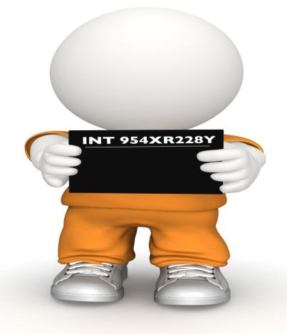
What is ‘The Prisoner's Dilemma’?
Let us now consider that there are two suspects named Billy Jean and Harry Luke.
These two suspects have been arrested under the suspicion that they were involved in the plotting and the murder of an old man.

Slide 20
What is ‘The Prisoner's Dilemma’?
Detectives George Callaghan and Howard Poirot put the two suspects in different custody rooms. These detectives then question the suspects, one at a time. The detectives have not found any evidence that hints that either of the suspects was actually involved in the murder. However, they have found some proof that the suspects were involved in holding up the victim and stealing his wallet.

Slide 21
What is Nash Equilibrium?
Nash equilibrium is one of the central solution concepts for games.
The simplest idea of a ‘Nash Equilibrium’ is that if each player chooses their part of the Nash Equilibrium strategy, then no other player has a reason to diverge to another strategy.
A coordination game is a simple example of a Nash Equilibrium.
In the following coordination game, both (H, h) and (T, t) are Nash Equilibrium.

Slide 22
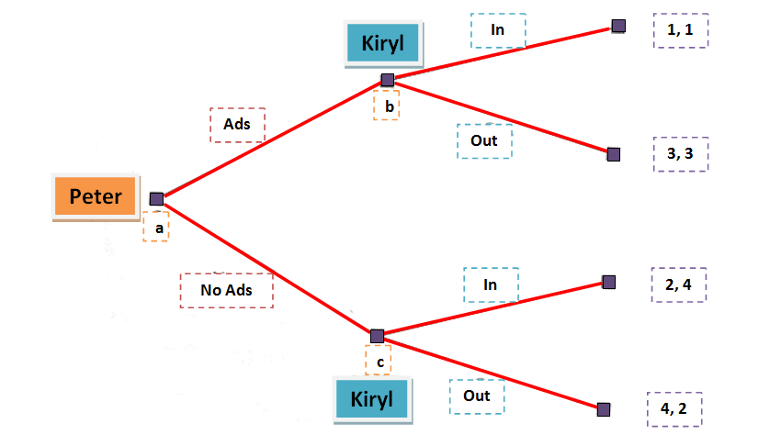
The Game Tree
As shown in the image, the payoffs for the two players are shown at the terminal points of the tree.

Slide 23
Equilibrium
Equilibrium
Equilibrium:
If the game strategy is to play optimal based on the fact about some correct beliefs about others, then you should adopt a strategy of using equilibrium.
So, using a equilibrium strategy is where know about the other players’ beliefs and moves and then try to reach an equilibrium in the game through your moves.

Slide 24
ManagementStudyGuide.com
This is a DEMO Course On – Strategic Game Theory for Managers. The Complete Course Consists of 237 Slides.
Join MSG and Get Access to Unlimited Courses for Lifetime.
What You Get:
View All Course Modules Online.
Download Powerpoint Presentation for Each Course.
Do the Knowledge Checks for Each Course.
Get Access to New Courses Every Week.

