Slide 1
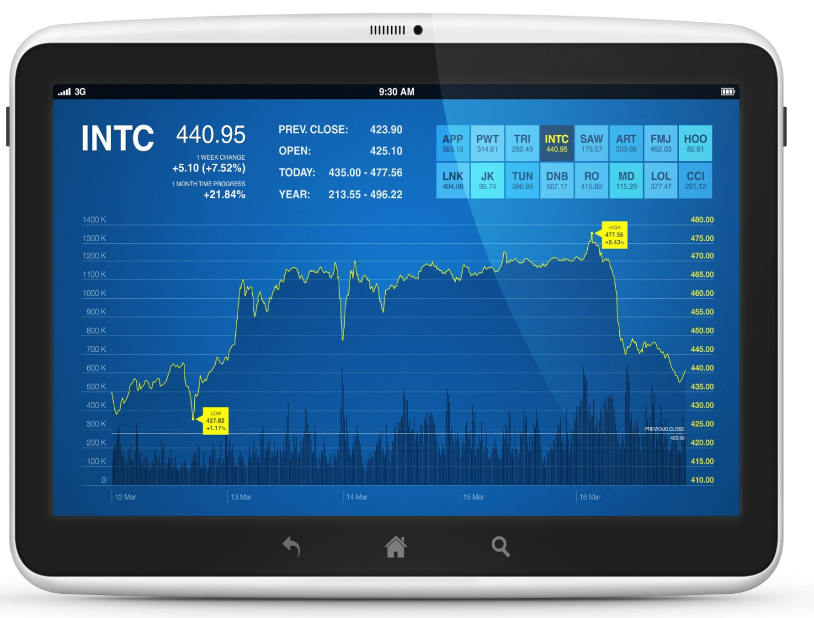
Stocks and Investing

Slide 2
Course Objectives
Explain What is a Stock
Explain the Types of Stocks
Explain the Classification of Common Stock
Describe the Role of Beta in Your Portfolio
List the Various Stock Screening Criteria
Explain the Types of Analysis in Stock Trading
Explain the Ratios for Valuing Firms
List the Criteria for Choosing a Broker
Explain the Common Stock Investing Strategies
Explain the Steps of a Typical Stock Transaction
Explain How to Read Stock Quotations
Explain the Calculation of Price-to-Earnings Ratio (PE)
Explain the Key Terms of Stocks and Investments
Describe the Rights of a Stockholder
Describe the Various Investment Options

Slide 3
Introduction
Peter Looney works as an executive.
For a long time, Peter has felt that he should invest the extra amount of money that he makes from his job.

Slide 4
Introduction
He has been saving in cash form for a long time.
However, he wants that he should use the saved amount to invest in something that could help him multiply his money and help grow his finances.

Slide 5
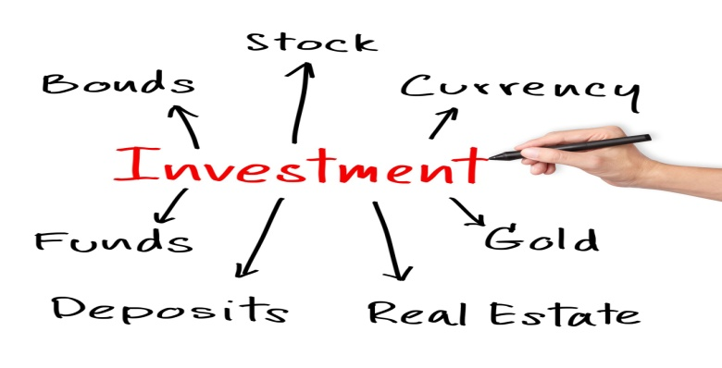
Introduction
Peter has always thought of starting a business venture to grow his money, however, he is greatly averse to the huge amount of risk involved in any business venture.
So, Peter starts asking advice from his colleagues about what possible investment options are available in the market.

Slide 6
ManagementStudyGuide.com
This is a DEMO Course Presentation On – Stocks and Investing.
Register Today and Get Access Complete Course Presentations on more than 150 Topics.
What Do you Get:
View All Courses Online.
Download Powerpoint Presentation for Each Course.
100% Editable Presentations.

Slide 7
Introduction
George, one of Peter’s colleagues, advices him to invest in stocks and mutual funds.
Stocks are the capital raised by a corporation through the issue of shares entitling holders to an ownership interest also known as ‘equity’.

Slide 8
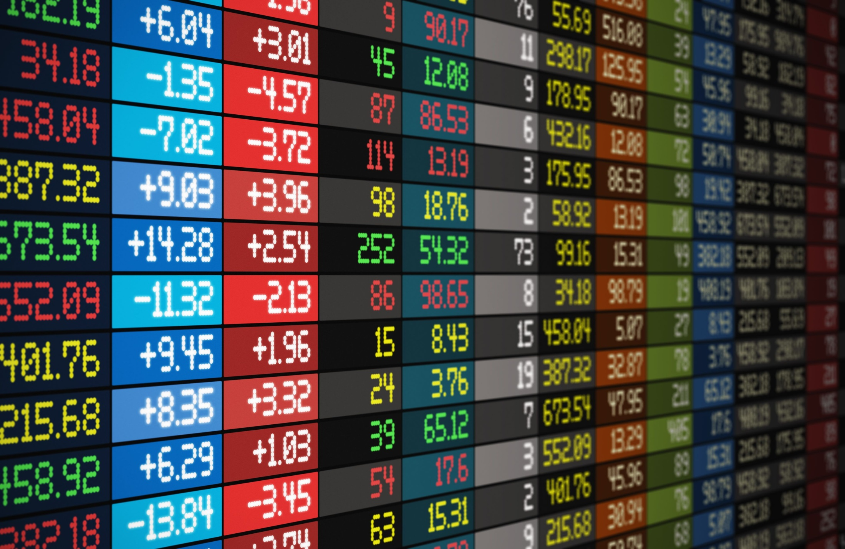
What is a Stock?
Any business needs money or capital whenever it has to start its operations or expand its business operations.
Thus, in order to raise this capital for a business start-up or expansion, the corporation would offer shares of stock for sale to the public.

Slide 9
Cyclical Stocks
Cyclical Stocks
Cyclical Stocks:
‘Cyclical Stock’ is stock exhibiting above-average sensitivity to the business cycle.
These are issue by companies whose share prices move up and down with the state of the economy.

Slide 10
Understanding Leverage
1
‘Leverage’ is another important concept while learning about stocks and investing. ‘Leverage’ is the process of increasing your purchasing power by borrowing money to invest in more assets.
2
Therefore, it is very natural that the ‘Leverage’ increases your risk as you invest more than your own financial capacity by borrowing from others.
3
Also, when you borrow money for investing the rate of return on the loan is fixed, however, there is no fixed or guaranteed rate of return on your investments.

Slide 11
Political or Regulatory Risk
Political or Regulatory Risk
Political or Regulatory Risk:
‘Political or Regulatory Risk’ is a risk that unanticipated changes in the tax or legal environment will have an adverse impact on a business.

Slide 12
ManagementStudyGuide.com
This is a DEMO Course Presentation On – Stocks and Investing.
Register Today and Get Access Complete Course Presentations on more than 150 Topics.
What Do you Get:
View All Courses Online.
Download Powerpoint Presentation for Each Course.
100% Editable Presentations.

Slide 13
Stock Screening Criteria
It is very important that you should screen each and every stock that you intend to buy or sell before deciding on a purchase or sale.
Screening the stock carefully on certain crucial criteria will help you make informed and wise decision to safeguard your money against risk as well as losses.

Slide 14
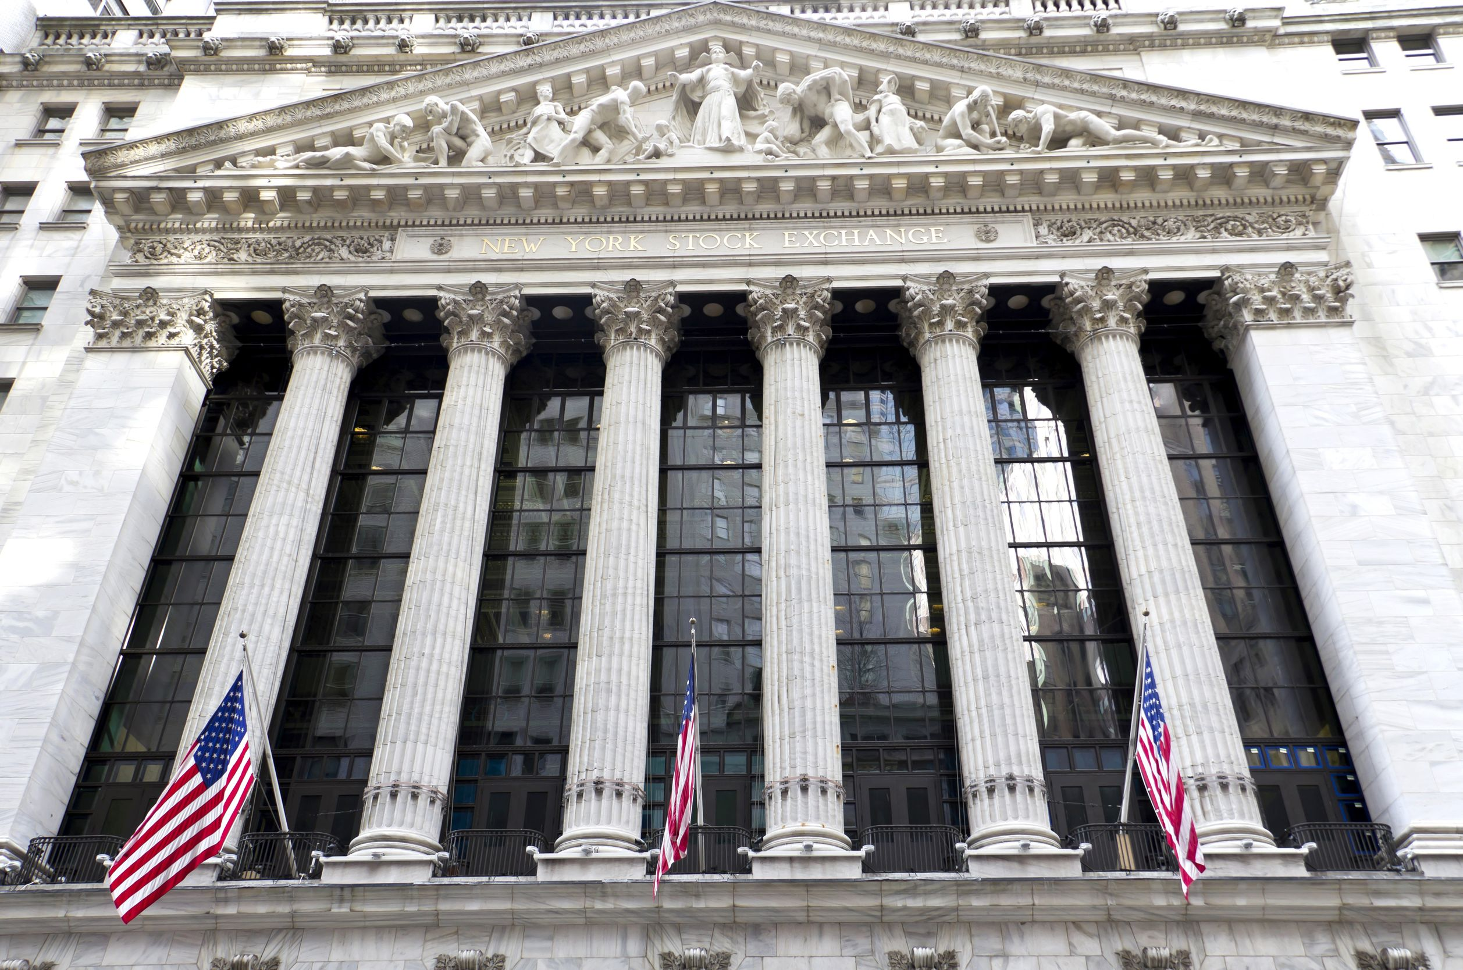
Stock Indexes of the US
You can find out information about every stock and the important financial news for a given day from the financial indexes that are published in newspapers.
Many leading daily newspapers and daily publications such as the Wall Street Journal, Investors Daily publish the latest stock trading information for the various exchanges.

Slide 15
Reading Stock Quotations
52 WEEK CYCLE
Let us now look at the table and try to read the stock quotation shown:
HI | LOW | STOC | SYMBOL | DIV | YLD | PE | VOL IN 100S | HI | LO | CLOSE | CHANGE
129 | 83 | IBM | IBM | $1.40 | 1.2% | 19 | 17.9987 | 114 | 113 | 113 | -1
The second column ‘LOW’ shows the 52-week lowest
value of the IBM stock as $83.00.

Slide 16
Reading Stock Quotations
52 WEEK CYCLE
Let us now look at the table and try to read the stock quotation shown:
HI | LOW | STOC | SYMBOL | DIV | YLD | PE | VOL IN 100S | HI | LO | CLOSE | CHANGE
129 | 83 | IBM | IBM | $1.40 | 1.2% | 19 | 17.9987 | 114 | 113 | 113 | -1
The ninth column ‘HI’ shows the previous day’s highest
value of the IBM stock as $114.00.

Slide 17
Classifications of Bonds
Bonds can be classified into the following based on various criteria:
Transfer Method
Collateral:
Bonds are classified based on the kind of collateral offered into the following two types:
Secure Bond: ‘Secured Bond’ is a bond for which interest and principal payments are backed by assets or future cash flows pledged as collateral. Thus, a secured bond is fully secured by a specific asset that can be sold by the bondholder to satisfy a claim.
Debenture: ‘Debentures’ are ‘unsecured bonds’ in the form of a certificate or voucher acknowledging a debt. Thus, a debenture or unsecured bond is secured only by the issuer's reputation and credit.
Price
Maturity
Convertibility
Collateral

Slide 18
The Bulls
When you start investing in the stock market, two of the very popular terms that you would hear is the ‘Bulls’ and the ‘Bears’.
The ‘Bulls’ is used to refer to an investor with an optimistic market outlook.
Hence, a ‘bull’ is an investor who expects prices to rise and so buys now for resale later.
Similarly, a ‘bull’ market is when everything in the economy is going great, people are finding jobs, Gross Domestic Product (GDP) is growing, and stocks are rising.
So, a ‘bull’ market is one where stock prices are rising.

Slide 19
ManagementStudyGuide.com
This is a DEMO Course On – Stocks and Investing.
Register Today and Get Access to FREE Courses.
What Do you Get:
View All Courses Online.
Download Powerpoint Presentation for Each Course.
Do the Knowledge Checks for Each Course.

