Slide 1
20%
80%
Pareto Analysis

Slide 2
Course Objectives
Describe the History of Pareto Analysis
Explain What is the Pareto Principle
Explain Vital Few and Trivial Many Principle
List the Uses of Pareto Principle
List the Examples of Pareto Principle
List the Applications of Pareto Analysis
Explain What is Pareto Analysis
Explain Pareto Charts
List the Uses of Pareto Analysis
Explain the Process of Pareto Analysis
Explain When to Use a Pareto Chart
Explain How to Use Pareto Charts
Explain the Phases of Pareto Analysis
Explain Pareto Frequency Diagram
Explain the Steps for Boosting Productivity

Slide 3
Introduction
Keith Sutherland is a Manager in Helios Inc.
He finds that he is always loaded and pressurized with tons of workload.
Despite Keith’s several efforts to complete all his tasks, he finds that he always fails at completing some of the tasks as well as ends up missing many of his task deadlines.

Slide 4
Introduction
One day, Keith is asked to attend a training program on ‘Pareto Analysis’ which was organized by the HR as part of the Learning and Development program of the company.
Pareto
Analysis
At this training program, Keith found the answer to all his problems.
Would you like to know how? Let us see what Keith learned at this training program.

Slide 5
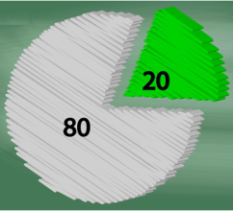
Introduction
Keith learned that as per ‘Pareto Analysis’, ‘80% of output is achieved from 20% of the input such as resources of time, manpower etc.’
20% -Time
80% -Tasks
So, Keith analyzed his daily routine that he follows and found that ‘Pareto Analysis’ was right.
He achieved 80% of his tasks from only 20% of the actual time that he spent on working.

Slide 6
Introduction
The rest of his time was getting wasted in checking emails, attending unproductive meetings, conference calls that deviated from the set agenda, following up on the list of tasks assigned to his subordinates etc.

Slide 7
ManagementStudyGuide.com
This is a DEMO Course Presentation On – Pareto Analysis.
Register Today and Get Access Complete Course Presentations on more than 150 Topics.
What Do you Get:
View All Courses Online.
Download Powerpoint Presentation for Each Course.
100% Editable Presentations.

Slide 8
Introduction
Therefore, practically, the actual amount that he worked on his core productive tasks was just 20%.
Keith decided to improve his time management skills.

Slide 9
Introduction
He decided to check his mails only once every hour, he made sure that his meetings and conference calls stuck to the set agenda and were completed as scheduled and he asked his subordinates to submit a status message to him at the end of the day.
Check once every hour
Submit status at the end of the day.
Stuck to set agenda
Completed as scheduled

Slide 10
Introduction
So, he stopped wasting his time on such unproductive tasks and concentrated his efforts on meaningful tasks.
Let us learn about ‘Pareto Analysis’ in detail.
So, Keith used ‘Pareto Analysis’ for effective time management.
However, ‘Pareto Analysis’ is not just about time management, its concept and applications are widespread.

Slide 11
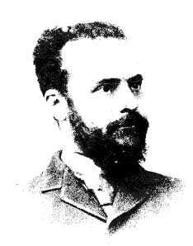
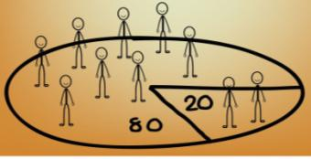
History of Pareto Analysis
A famous Italian economist, Vilfredo Pareto found the ‘Pareto Principle’ or ‘Pareto Analysis’ in 1879.
Pareto based his principle on a research in which he found that 80% of Italy’s wealth was held by 20% of its population.

Slide 12
The ‘Pareto Principle’
‘The Law of The Vital Few and the Trivial Many’
The ‘Power Law’
Different Names of Pareto Analysis
‘Participation Inequality’
‘Pareto Analysis’ is known by many different names such as:
The ‘80 – 20 Rule’
ABC Analysis Technique
‘Principle of Imbalance’

Slide 13
Uses of Pareto Principle
The following are some of the uses of Pareto Analysis:
It helps to reduce operating costs
It is used to bridge the gap between efforts and achievements
It helps to grow and develop the business
It helps to identify crucial problems
It helps you to focus on and use your core strengths

Slide 14
ManagementStudyGuide.com
This is a DEMO Course Presentation On – Pareto Analysis.
Register Today and Get Access Complete Course Presentations on more than 150 Topics.
What Do you Get:
View All Courses Online.
Download Powerpoint Presentation for Each Course.
100% Editable Presentations.

Slide 15
Examples of Pareto Principle
The following are a few examples of Pareto Principle:
20% of the Input – Produces 80% of the Output
20% of the Efforts - Produces 80% of the Products
20% of the repairs - Consume 80% of repair costs

Slide 16
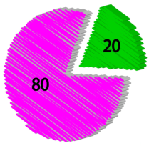
Real Life Example
Ian Mitchinson has joined Helios as the new Vice President (Marketing).
Helios Inc. is a leading manufacturer of cosmetics.
Ian decides to conduct a Pareto Analysis of the sales figures to identify its core customers who account for the major component of Helios’ profit.

Slide 17
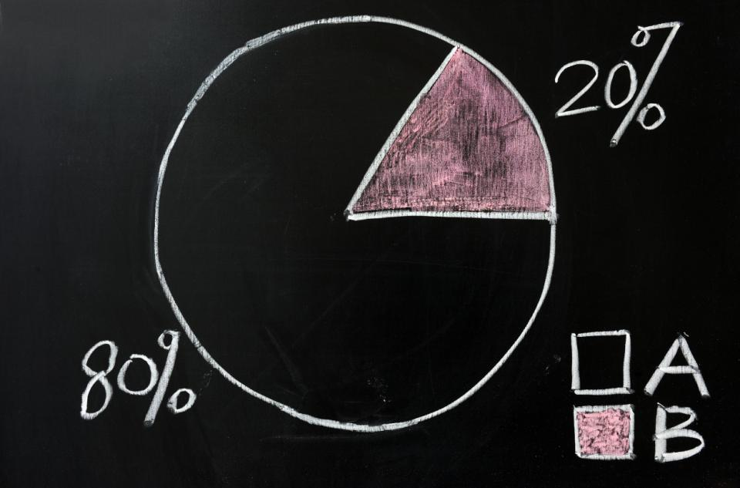
What is Pareto Analysis?
Applying the Pareto Principle to errors and defects helps us to understand that a disproportionately large percentage of errors or defects in any process are usually caused by relatively few problems.
Pareto Analysis helps to identify the most significant few errors or problems so that they can be targeted for correction or resolution.

Slide 18
Phases of Pareto Analysis
Phase I
Phase I
Phase I: Identification of Causes of Defects
The first phase of conducting a Pareto Analysis is identifying all the possible defects that result in an inferior quality. You can find all the characteristics that can be labeled as a ‘defect’ by collecting data through: brainstorming, focus groups, surveys, or any other method appropriate to the given business. You should aim at finding all actionable items that result in inferior quality.
Phase II
Phase III
Phase IV

Slide 19
Steps to Implement 80/20 Rule for Boosting Productivity
It is very important to keep your productivity at your maximum in whatever profession you might be. The following are the steps to help you boost your productivity keeping in mind the 80/20 Rule:
1
Maintain a log of your tasks for a week
80/20
2
Make a list of all your tasks/activities
Also, list the time that you would require to complete each task/activity
This list will help you get a true picture of your work week
3
4
5
Let us look at each in detail.

Slide 20
ManagementStudyGuide.com
This is a DEMO Course On – Pareto Analysis.
Register Today and Get Access to FREE Courses.
What Do you Get:
View All Courses Online.
Download Powerpoint Presentation for Each Course.
Do the Knowledge Checks for Each Course.

